Slide 1
CSEE5590-0001/490-0003: Big Data Programming
Lesson: 2

Slide 2
Hadoop MapReduce and Hadoop Distributed File System (HDFS)

Slide 3

Overview
Hadoop
Hadoop MapReduce
Hadoop Distributed File System (HDFS)
Use case – Wordcount
ICP – Counting frequency of words in the given input using MapReduce paradigm
Counting frequency of words staring with ‘a’

Slide 4
Prerequisites
Ensure that Hadoop is installed, configured and is running. More details:
Single Node Setup for first-time users.
Cluster Setup for large, distributed clusters.

Slide 5
Hadoop (Version 2.9.o)
Apache Hadoop is a software framework that supports data-intensive distributed applications under a free license
It enables applications to work with thousands of computational independent computers and petabytes of data
Open Source Implementation of MapReduce by Apache Software Foundation.
Created by Doug Cutting.
Derived from Google's MapReduce and Google File System (GFS) papers.
Source: http://hadoop.apache.org/ and https://www.slideshare.net/

Slide 6
Hadoop Architecture
Hadoop MapReduce
Single master node, many worker nodes
Client submits a job to master node
Master splits each job into tasks (MapReduce), and assigns tasks to worker nodes
Hadoop Distributed File System (HDFS)
Single name node, many data nodes
Files stored as large, fixed-size (e.g. 64MB) blocks
HDFS typically holds map input and reduce output
Source: https://www.slideshare.net/

Slide 7


Secondary Namenode
Hadoop Architecture
Namenode
JobTracker
Data node
Data node
Data node
TaskTracker
TaskTracker
TaskTracker
Map
Map
Map
Map
Map
Map
Map
Map
Map
Source: https://www.slideshare.net/
Ma_{M}p_{ap}
Map
Ma_{M}p_{ap}
Reduce
^{M}Reªd^{p}uce
Reduce

Slide 8
Job Scheduling in Hadoop
One map task for each block of the input file
Applies user-defined map function to each record in the block
Record = <key, value>
User-defined number of reduce tasks
Each reduce task is assigned a set of record groups
For each group, apply user-defined reduce function to the record values in that group
Reduce tasks read from every map task
Each read returns the record groups for that reduce task
Source: https://www.slideshare.net/

Slide 9
Dataflow in Hadoop
Map tasks write their output to local disk
Output available after map task has completed
Reduce tasks write their output to HDFS
Once job is finished, next job's map tasks can be scheduled, and will read input from HDFS
Therefore, fault tolerance is simple: simply re- run tasks on failure
No consumers see partial operator output
Source: https://www.slideshare.net/

Slide 10
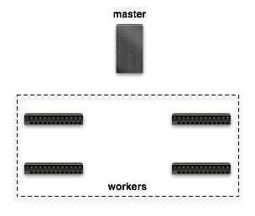











Dataflow in Hadoop
Submit job
map
schedule
reduce
map
reduce
Source: https://www.slideshare.net/

Slide 11



Dataflow in Hadoop
Read Input File
map
reduce
Block 1
HDFS
Block 2
map
reduce
Source: https://www.slideshare.net/

Slide 12









Dataflow in Hadoop
map
reduce
Local
FS
HTTP GET
map
Local
reduce
FS
Source: https://www.slideshare.net/

Slide 13







Dataflow in Hadoop
Write Final Answer
HDFS
reduce
reduce
Source: https://www.slideshare.net/

Slide 14
Hadoop MapReduce
Splits input files into blocks (typically of 64MB each)
Operates on key/value pairs
Mappers filter & transform input data
Reducers aggregate mappers output
Efficient way to process the cluster:
Move code to data
Run code on all machines
Source: https://www.slideshare.net/

Slide 15
Mapper
Mapper maps input key/value pairs to a set of intermediate key/value pairs
Maps are the individual tasks that transform input records into intermediate records
The transformed intermediate records do not need to be of the same type as the input records
A given input pair may map to zero or many output pairs
Source: https://hadoop.apache.org/docs/r1.2.1/mapred_tutorial.html

Slide 16
Reducer
Reducer reduces a set of intermediate values which share a key to a smaller set of values
Reducer has 3 primary phases:
shuffle
sort
reduce
Source: https://hadoop.apache.org/docs/r1.2.1/mapred_tutorial.html

Slide 17
Reducer
Shuffle
Input to the Reducer is the sorted output of the mappers
In this phase the framework fetches the relevant partition of the output of all the mappers, via HTTP
Sort
The framework groups Reducer inputs by keys (since different mappers may have output the same key) in this stage
The shuffle and sort phases occur simultaneously; while map-outputs are being fetched they are merged
Reduce
In this phase the reduce method is called for each <key, (list of values)> pair in the grouped inputs
The output of the reduce task is typically written to the FileSystem
The output of the Reducer is not sorted
Source: https://hadoop.apache.org/docs/r1.2.1/mapred_tutorial.html

Slide 18
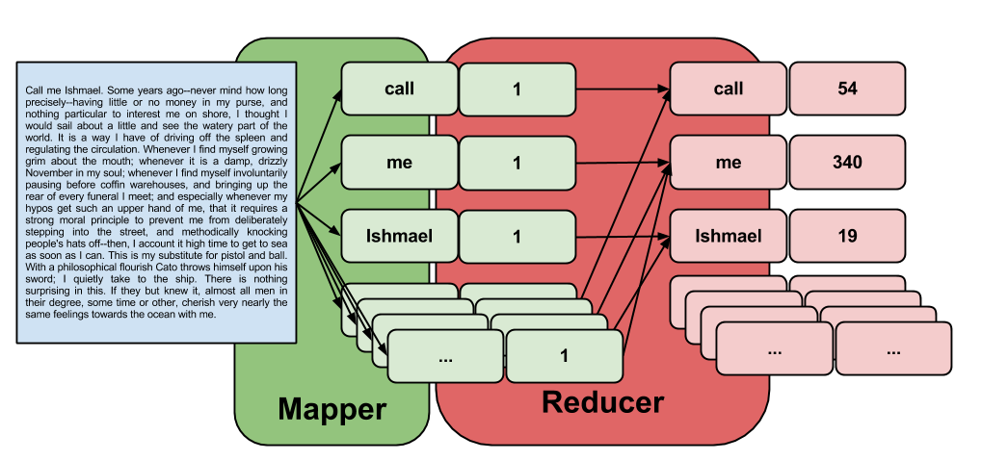
Hadoop MapReduce
Source: http://www.glennklockwood.com/data-intensive/hadoop/streaming.html

Slide 19
Hadoop Distributed File System (HDFS)
Data is distributed and replicated over multiple machines.
Files are not stored in contiguously on servers broken up into blocks.
Designed for large files (large means GB or TB)
Block Oriented
Linux Style commands (eg. ls, cp, mkdir, mv)
Source: https://www.slideshare.net/

Slide 20
Hadoop Distributed File System (HDFS)
The Hadoop Distributed File System (HDFS) is a distributed file system designed to run on commodity hardware
HDFS is highly fault-tolerant and is designed to be deployed on low-cost hardware
HDFS provides high throughput access to application data and is suitable for applications that have large data sets
HDFS relaxes a few POSIX requirements to enable streaming access to file system data
HDFS was originally built as infrastructure for the Apache Nutch web search engine project
HDFS is part of the Apache Hadoop Core project
Source: https://hadoop.apache.org/docs/stable/hadoop-project-dist/hadoop-hdfs/HdfsDesign.html

Slide 21

Hadoop Distributed File System (HDFS)
Source: https://hadoop.apache.org/docs/stable/hadoop-project-dist/hadoop-hdfs/HdfsDesign.html

Slide 22
Hadoop Distributed File System (HDFS)
NameNode and DataNodes
HDFS has a master/slave architecture
An HDFS cluster consists of a single NameNode, a master server that manages the file system namespace and regulates access to files by clients
In addition, there are a number of DataNodes, usually one per node in the cluster, which manage storage attached to the nodes that they run on
HDFS exposes a file system namespace and allows user data to be stored in files
Internally, a file is split into one or more blocks and these blocks are stored in a set of DataNodes
Source: https://hadoop.apache.org/docs/stable/hadoop-project-dist/hadoop-hdfs/HdfsDesign.html

Slide 23
Hadoop Distributed File System (HDFS)
NameNode and DataNodes
The NameNode executes file system namespace operations like opening, closing, and renaming files and directories
It also determines the mapping of blocks to DataNodes
The DataNodes are responsible for serving read and write requests from the file system’s clients
The DataNodes also perform block creation, deletion, and replication upon instruction from the NameNode
The NameNode and DataNode are pieces of software designed to run on commodity machines
Source: https://hadoop.apache.org/docs/stable/hadoop-project-dist/hadoop-hdfs/HdfsDesign.html

Slide 24
Hadoop Distributed File System (HDFS)
NameNode and DataNodes
These machines typically run a GNU/Linux operating system (OS)
HDFS is built using the Java language; any machine that supports Java can run the NameNode or the DataNode software
Usage of the highly portable Java language means that HDFS can be deployed on a wide range of machines
A typical deployment has a dedicated machine that runs only the NameNode software
Each of the other machines in the cluster runs one instance of the DataNode software
Source: https://hadoop.apache.org/docs/stable/hadoop-project-dist/hadoop-hdfs/HdfsDesign.html

Slide 25
Hadoop Distributed File System (HDFS)
NameNode and DataNodes
The architecture does not preclude running multiple DataNodes on the same machine but in a real deployment that is rarely the case
The existence of a single NameNode in a cluster greatly simplifies the architecture of the system
The NameNode is the arbitrator and repository for all HDFS metadata
The system is designed in such a way that user data never flows through the NameNode
Source: https://hadoop.apache.org/docs/stable/hadoop-project-dist/hadoop-hdfs/HdfsDesign.html

Slide 26
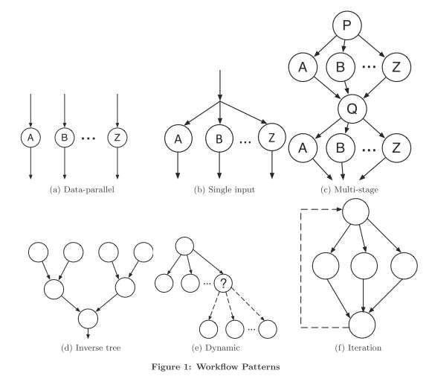
Different Workflows
Source: https://www.slideshare.net/

Slide 27
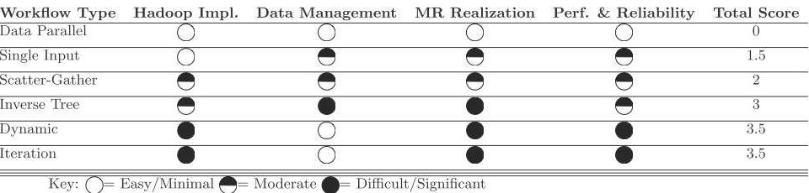
Hadoop Applicability by Workflow
Score Meaning:
Score Zero implies Easily adaptable to the workflow
Score 0.5 implies Moderately adaptable to the workflow
Score 1 indicates one of the potential workflow areas where Hadoop needs improvement
Source: https://www.slideshare.net/

Slide 28
Relative Merits and Demerits of Hadoop Over DBMS
Pros
Fault tolerance
Self Healing rebalances files across cluster
Highly Scalable
Highly Flexible as it does not have any dependency on data model and schema
Cons
No high level language like SQL in DBMS
No schema and no index
Low efficiency
Very young (since 2004) compared to over 40years of DBMS
Hadoop | Relational
Scale out (add more machines) | Scaling is difficult
Key/Value pairs | Tables
Say how to process the data | Say what you want (SQL)
Offline/ batch | Online/ realtime
Source: https://www.slideshare.net/

Slide 29
Conclusions and Future Work
MapReduce is easy to program
Hadoop=HDFS+MapReduce
Distributed, Parallel processing
Designed for fault tolerance and high scalability
MapReduce is unlikely to substitute DBMS in data warehousing instead we expect them to complement each other and help in data analysis of scientific data patterns
Finally, Efficiency and especially I/O costs needs to be addressed for successful implications
Source: https://www.slideshare.net/

Slide 30
Hadoop Commands
https://hadoop.apache.org/docs/r2.4.1/hadoop-project-dist/hadoop-common/FileSystemShell.html

Slide 31
References for papers
[LLCCM12] Kyong-Ha Lee, Yoon-Joon Lee, Hyunsik Choi, Yon Dohn Chung, and Bongki Moon, ͞Parallel data processing with MapReduce: a surveǇ,͟ SIGMOD, January 2012, pp. 11-20.
[MTAGS11] Elif Dede, Madhusudhan Govindaraju, Daniel Gunter, and Lavanya Ramakrishnan, ͞ RidiŶg the Elephant: Managing Ensembles with Hadoop,͟ Proceedings of the 2011 ACM international workshop on Many task computing on grids and supercomputers, ACM, New York, NY, USA, pp. 49-58.
[DG08]Jeffrey Dean and Sanjay Ghemawat, ͞MapReduĐe: simplified data processing on large Đlusters,͟ January 2008, pp. 107-113. ACM.
[CAHER10]Tyson Condie, Neil Conway, Peter Alvaro, Joseph M. Hellerstein, Khaled Elmeleegy, aŶd Russell Sears, ͞MapReduĐe oŶliŶe,͟ Proceedings of the 7th USENIX conference on Networked systems design and implementation (NSDI'10), USENIX Association, Berkeley, CA, USA, 2010, pp. 21-37.
Source: https://www.slideshare.net/

Slide 32
References
http://hadoop.apache.org/docs/current/hadoop-project-dist/hadoop-common/CommandsManual.html
https://hadoop.apache.org/docs/r1.2.1/mapred_tutorial.html
https://hadoopi.wordpress.com/2013/05/25/setup-maven-project-for-hadoop-in-5mn/
http://bradhedlund.com/2011/09/10/understanding-hadoop-clusters-and-the-network/
Source: https://www.slideshare.net/

Slide 33
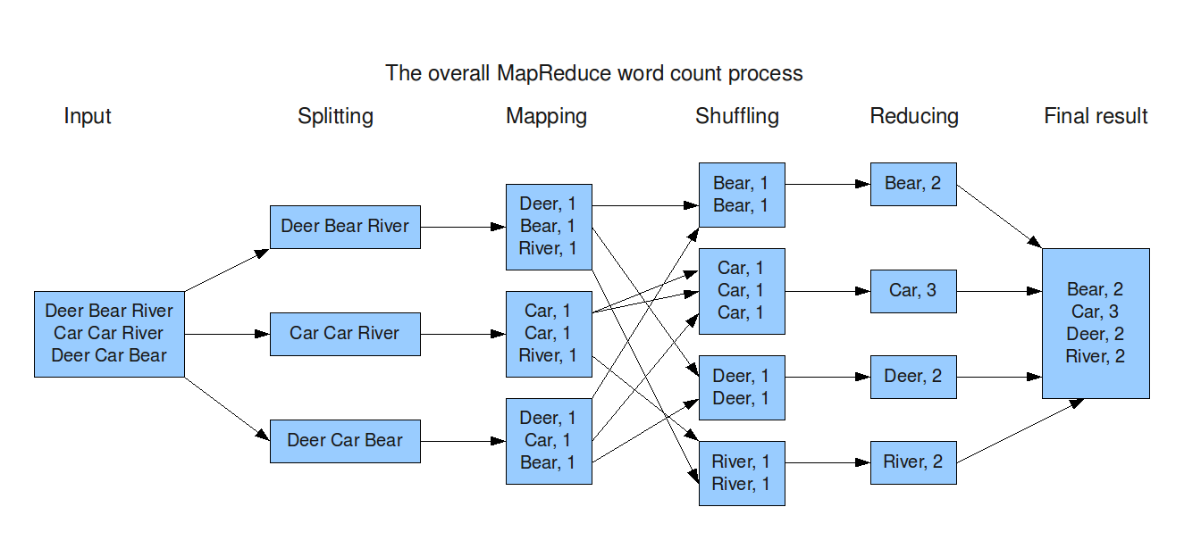
Use case

Slide 34
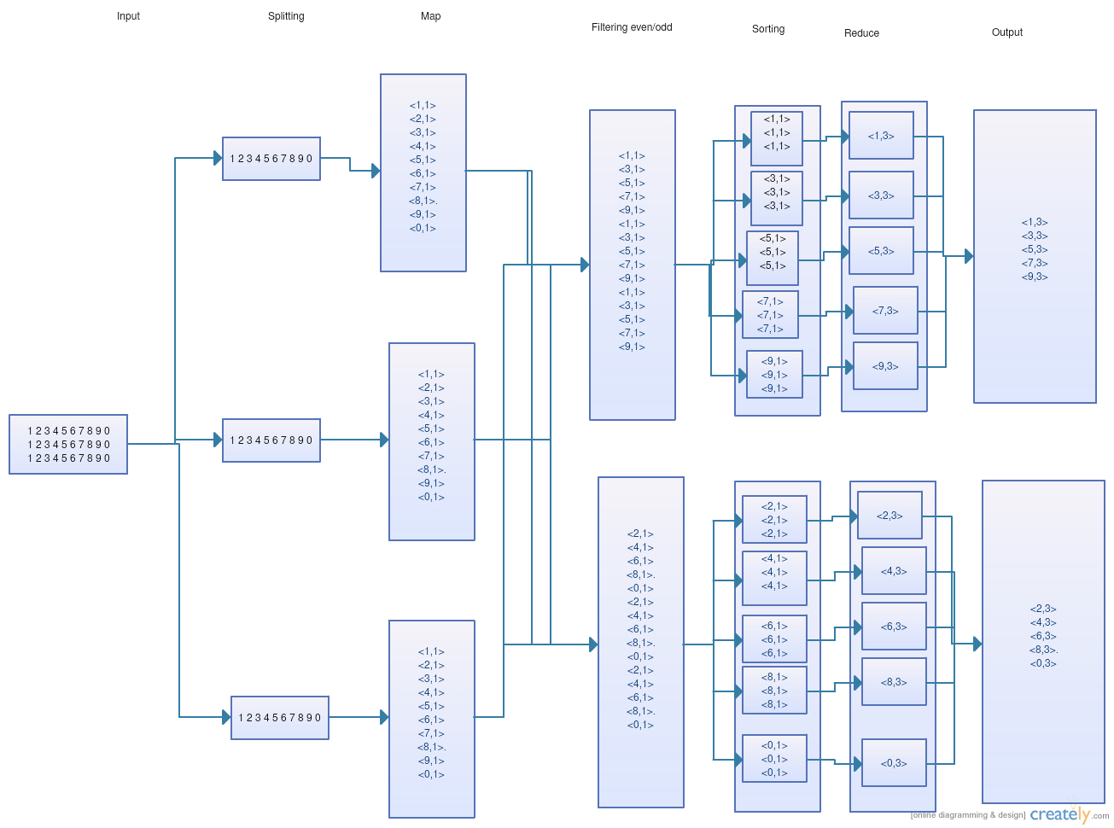
ICP

